Slide 1
Virtual Field Trips
By: Chelsea Blake Morgan Tank Kimberly Yuill

Slide 8
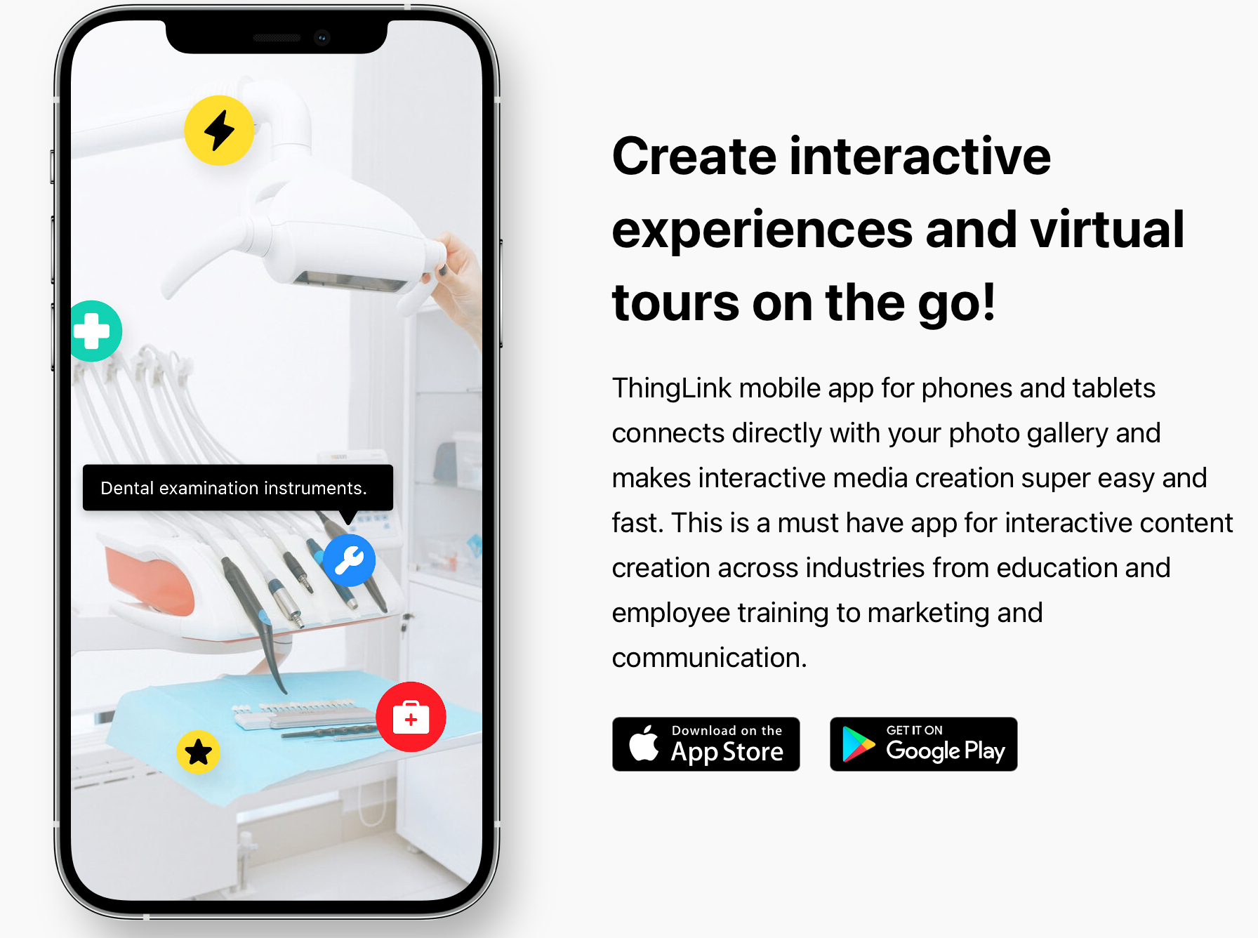
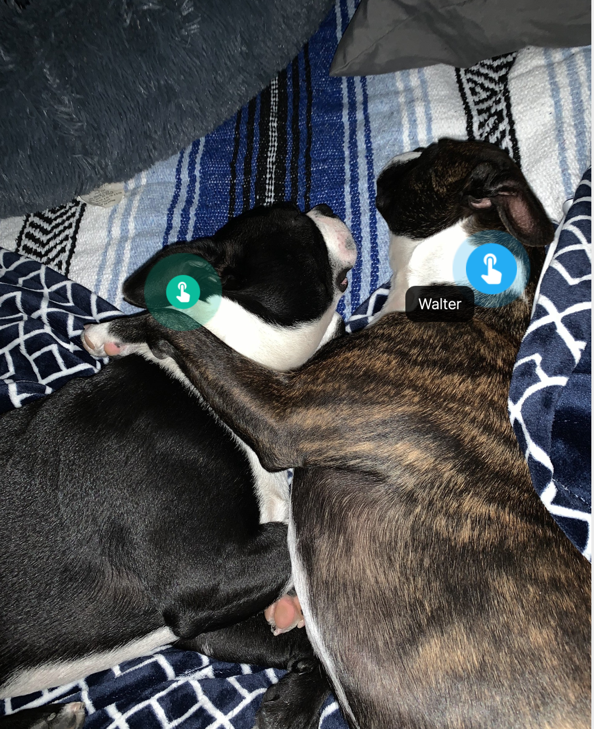
Supplemental Tools
https://jamboard.google.com/d/14reOfOv0cQCPEewWjPfSSVZtGDpYRXp8NGJlOOC4Y54/viewer?f=0
https://wow.boomlearning.com/play/EG8ytQGeRh2c9Dked/teacher
https://create.kaixr.com
https://www.canva.com
https://www.thinglink.com

Slide 11
Supplemental Tools
https://www.youtube.com/watch?v=kjdZ3Gs-PTk
https://www.screencastify.com/
https://www.jamboard.google.com
https://www.youvisit.com/tour/bdjh99/107331?id=813514
https://create.kahoot.it/details/9a712e6d-f69c-4e05-854e-2e88000bbd95
https://quizlet.com/ca/738359484/mt-st-helens-flash-cards/

